Slide 1
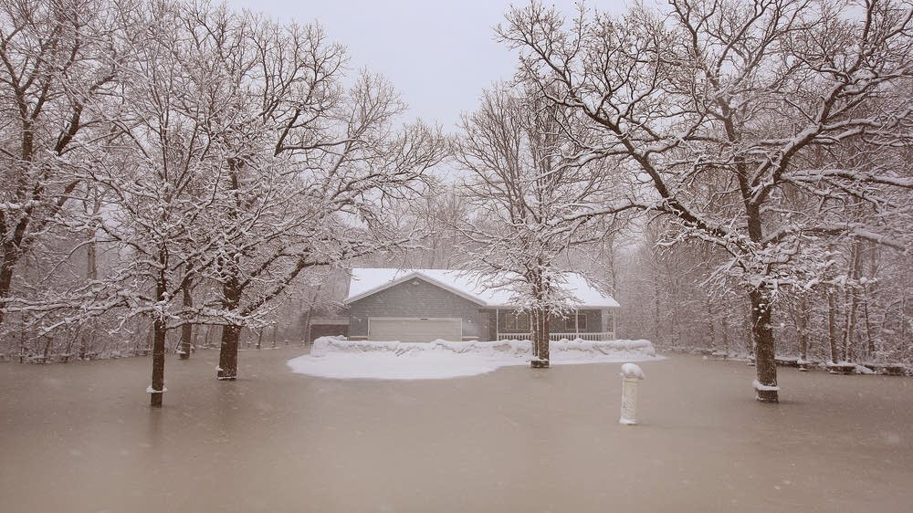
Working in the Winter

Slide 2
Guidelines for Performing Tasks in Winter
While no specific person spoke “Working in the Cold is Hard”, it’s a well know fact.
Cold weather impairs mental alertness, reduces dexterity, and strength in hands and feet.
North Carolina is also subject to heavy rain and storms year-round, and winter flooding presents significant risks.
Moreover, cold-related illnesses like frostbite and hypothermia, can be life threating.
Just Two Blocking
NCDOT

Slide 3
Working on a cold winter day and especially in floods, requires prioritizing safety by using appropriate gear, such as watertight boots and layers of warm clothing to prevent cold stress and injury.
Use proper work practices, such as avoiding direct contact with floodwaters, and washing hands.
Because cold water absorbs heat rapidly, it has immediate effects on exposed skin and the body in general. Staying dry should remain a priority. Ensure there are areas to reheat even in not in the water.
Managing Cold Weather

Slide 4
Managing Cold Weather
Essential Gear and Clothing:
Layer Clothing: Wear at least three layers of loose-fitting clothing, which trap heat and are easy to remove if you overheat.
Footwear is Crucial:
Wear insulated and watertight boots with good rubber treads to protect from water, punctures, and bites, as well as provide traction on slippery surfaces.
Protect Your Extremities:
Use heavy work gloves to protect your hands and wear a protective hat for your head.

Slide 5
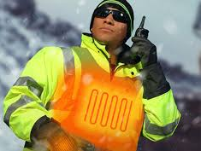
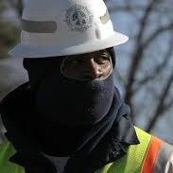
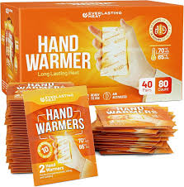
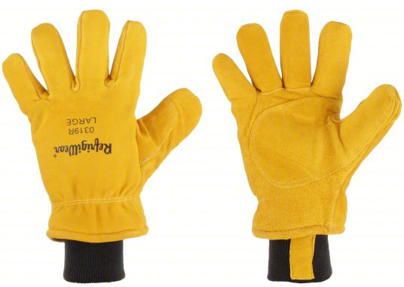
Consider Options to Managing Cold Weather

Slide 6
Questions
Contact Safety and Risk Management or your local Safety Representative

